Slide 1

Infant Monitoring System
Sponsored By – Connasys.com
Project by:
Divya Venkataramani
Jaikumar Ambekar
Aaishwarya Jadhav
Shubham Wadzirkar
Under the guidance of:
Internal Guide:
Prof. Kranti Dive
External Guide:
Mr. Gaurav Khadse

Slide 2
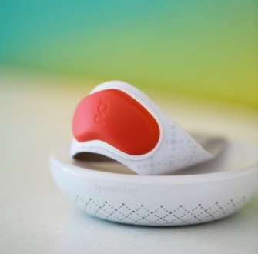
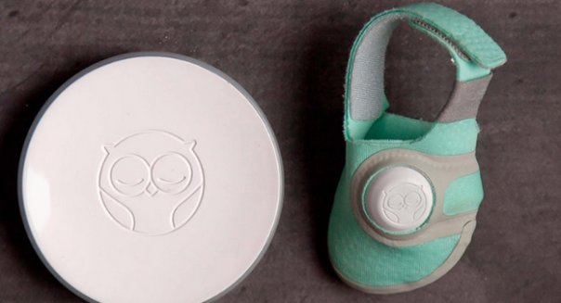
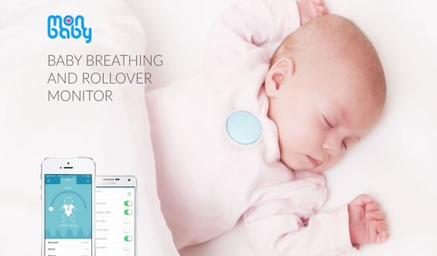
Introduction
Working parents don’t have time for the infant.
Difficult to interpret the infant’s behaviour in the initial stages.
IMS helps the parents by providing necessary alerts and vitals of the baby.
Notes:
Put paragraphs in points

Slide 3
Literature Survey
We have studied the existing systems in the market and various hardware technologies used for this project.

Slide 4
Literature Survey- Existing Systems
Parameter Existing System | Device Type | Parameters Monitored | Special Feature | Limitations
Sproutling Baby Monitor | Wearable Band for your baby | Heart rate, baby position, noise levels | Predicts baby’s sleep pattern and optimal sleep condition | Expensive
MonBaby Monitor | Wearable Smart button | Breathing and position using pulse oximeter | Real time in every 5 seconds. | Works optimally when placed in the same room with your smartphone
Owlet Baby Monitor | Wearable Sock-like device | Heart rate and oxygen levels | Detects sleep disturbances and breathing pattern | More effective with alerts if the baby and the parent are in the same room
Withings Baby Monitor | Stand up camera attachable to the crib | Room temperature, ideal environment, can talk to the baby | Smart light to fascinate baby, plays lullabies for baby | Does not measure any vitals Drains more battery since it monitors using a video camera
Notes:
Give an introduction of the literature survey, give headings for tables, list out advantages and disadvantages from each system

Slide 5
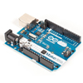
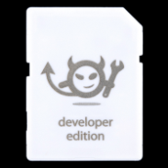
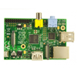
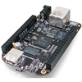
Literature Survey – Processors
Image
Board: | Arduino Uno | Electric Imp | Raspberry Pi | BeagleBone Black
Price: | $29.99 | $29.95 | $39.99 | $59.99
Processor: | ATmega328 | Cortex M3 | ARM1176JZF-S | Sitara ARM Cortex-A8
Processor Speed: | 16 MHz | 31 MHz | 700 MHz | 1 GHz
Memory: | SRAM 2KB - EEPROM 1KB | RAM 128KB, 64KB available to user | RAM 512MB | DRAM 512MB eMMC 2GB
Programming Language: | Arduino / C Variant | Squirrel | Any language supported | Any language supported
Assembled or Kit: | Assembled | SD card like device with embedded Wi-Fi transceiver | Assembled | Assembled

Slide 6
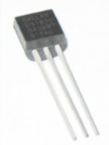
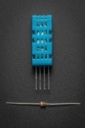
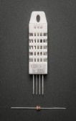
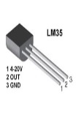
Literature Survey – Temperature sensors
TEMPERATURE SENSORS | Dallas DS1820 | DHT11 | DHT22 | LM35
DESCRIPTION | This device is 1-wire device. | It is a basic ultra-low-cost digital temperature sensor. | Basic ultra-low cost digital temperature sensor | It is common TO-92 temperature Sensor
ACCURACY | 0.5 º C | 2ºC | 0.5ºC | 0.4ºC
RANGE | -55 º C TO 125ºC | 0ºC TO +50ºC | -40ºC TO 80ºC | -55ºC TO +150ºC
LIBRARIES USE | One wire and Dallas temperature | Dhtlib | Dthlib | Temp=(5.0*AR*100/1024)
PRICE | $4.25 | $5 | $10 | 1.5$
SENSOR

Slide 7
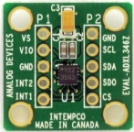
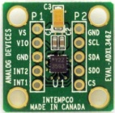
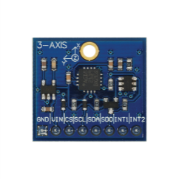
Literature Survey – Accelerometers
ACCELEROMETERS PARAMETERS | ADXL345 | ADXL335 | L3G4200D
IMAGE
POWER | Ultra Low power (0.1 µA) | Low power (350 µA) | Low power
SUPPLY VOLTAGE | 1.7 V to 2.5 V | 1.8 V to 3.6 V | 2.2 V to 3.6 V
RANGE | + - 16g | + - 3 g | + - 15g
HARDWARE | Accelerometer | Angular Rate Sensor | Motion Sensor
NO OF AXES | 3 | 3 | 3
MEASUREMENT AXIS | X, Y, Z | X, Y, Z | Pitch, Roll, Yaw
SPECIAL FEATURES | Fall detection measurement | No fall detection measurement | No fall detection measurement
COST | $ 7.64 | $ 4.99 | $ 4.30

Slide 8
Problem statement
To develop an infant monitoring system that measures baby’s vitals and provides alerts if anything goes abnormal

Slide 9
Block Diagram
LM 35
Temp sensor
Electric Imp
Android
application
Infrared Sensor
Database
server
Wi-Fi
Wi-Fi
ADXL 345
Figure 1: Block Diagram for working of IMS
Notes:
Give heading for the figure

Slide 10
Platform/Technology
The system consists of three phases-
Hardware Device
Database
Software Application.

Slide 11
Database Design
The database used is an unstructured database which stores key value pairs of the temperature, heart rate and position of the infant
The database has three channels:
Temperature channel
Heart rate channel
Position channel
The database stores data in a JSON format with the timestamp, id, and values

Slide 12
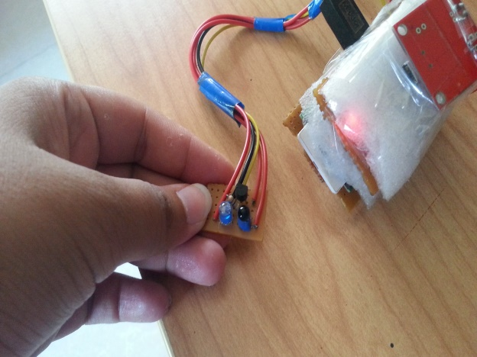

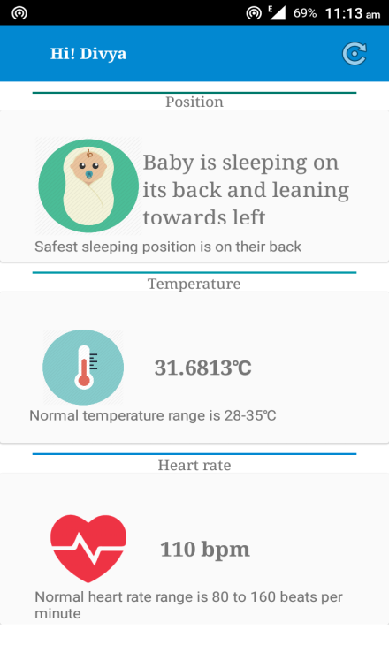
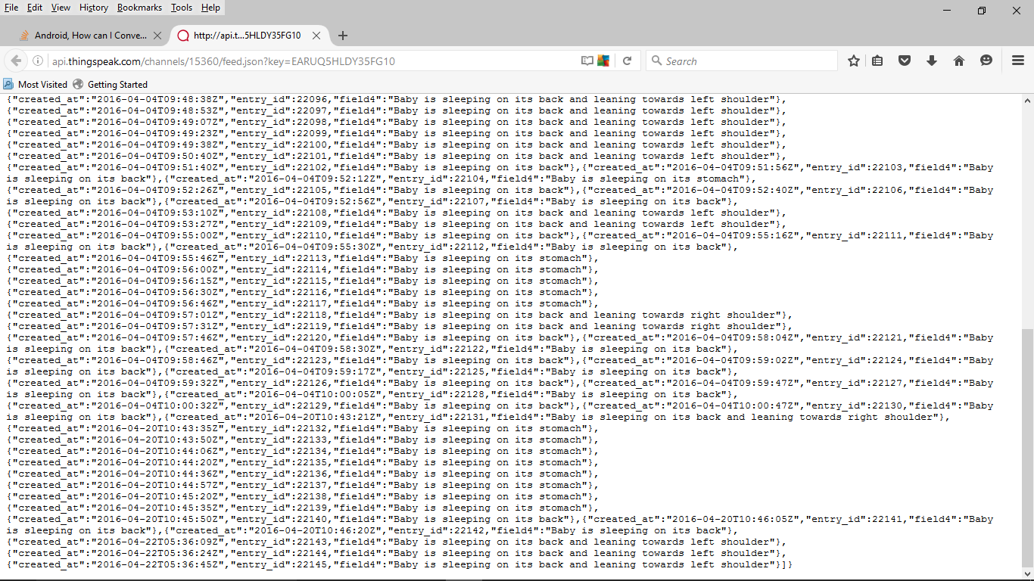
Implementation

Slide 13
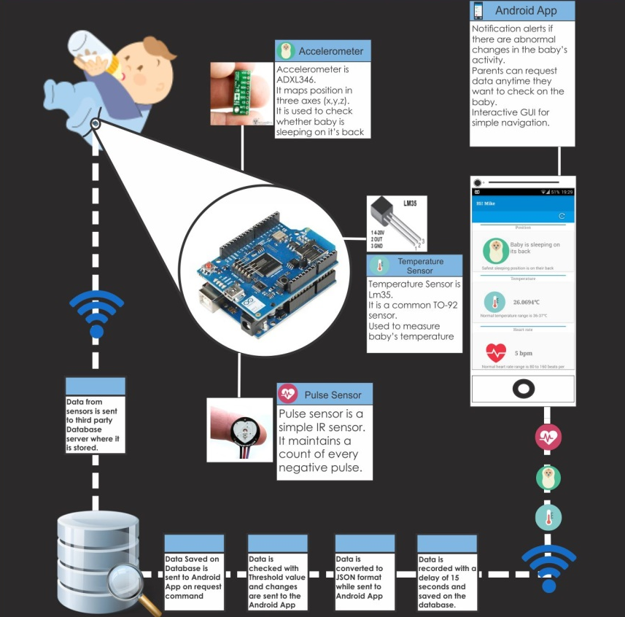
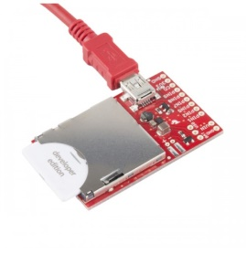
Implementation

Slide 14
Testing
Positive Testing
Negative Testing
Parameter | Expected Result | Result
Pulse(normal) | No alert generated | No alert generated
Temperature(normal) | No alert generated | No alert generated
Position(on the back) | No alert generated | No alert generated
Parameter | Expected Result | Result
Pulse <80bpm and >160bpm | Alert generated | Alert generated
Temperature >36ºC | Alert generated | Alert generated
Position(on the stomach | Alert generated | Alert generated

Slide 15
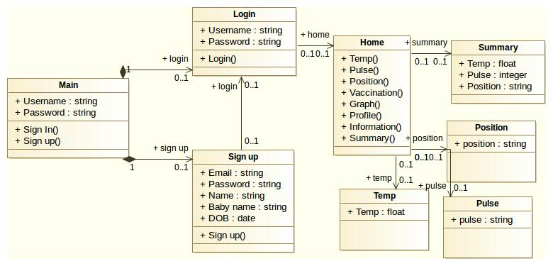
UML diagrams
Class diagram

Slide 16
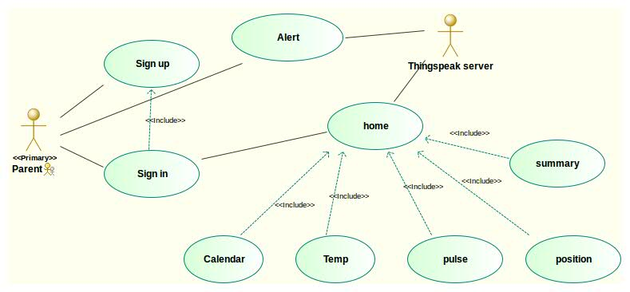
Use-Case Diagram

Slide 17
Result/Analysis
Accurate information 90% of the time
Noise reduction needs to be worked in case of infrared sensor for increase in accuracy
Notes:
Reduce the number of sentences, increase spacing

Slide 18
Applications
To measure the infant’s vitals at home by parents
To keep a check on the infants by easy monitoring and alert generation anywhere

Slide 19
Advantages
Works better even remotely as opposed to MonBaby
The existing system also adds a new feature, a vaccination schedule.

Slide 20
Limitations
Power consumption in mobile phones may vary according to the phone
The wearable device needs to be charged frequently

Slide 21
Conclusion
After a thorough study of existing systems we have proposed a system which combines the advantages of each system to provide a cheaper and better system.
The device to aims at developing a system that is futuristic and helps parents living in first world to lead a less exhausting life.
Notes:
Increase conclusion by adding on stuff about the lit survey

Slide 22
Future Scope
To include a cry detection by using a sound sensor and a database of cries as to why the baby was crying at that instant.
To map the voices of the cry sounds to the existing database to predict the reason of the infant’s cry.

Slide 23
References
[1]
G.Rajesh, R. Arun Lakshman, L. Hari Prasad and R. Chandira Mouli, “Baby monitoring system using wireless sensor networks” ,Published in ICTACT JOURNAL ON COMMUNICATION TECHNOLOGY, September 2014, Volume: 05, Issue: 03
Sibrecht Bouwstra, Wei Chen, Loe Feijs, Sidarto Bambang Oetomo M.D., “Smart Jacket Design for Neonatal Monitoring with Wearable Sensors”, Published in: Wearable and Implantable Body Sensor Networks, June 2009, Page(s):162 – 167
Wearable devices, “Tracked Since Birth: The Rise Of Extreme Baby Monitoring”, Available: http://www.fastcompany.com/3021601/innovation-agents/tracked-since-birth-the-pros-and-cons-of-extreme-baby-monitoring, 2014
Ziganshin E.G. ; NanoPulse, Inc., Moscow, Russia ; Numerov, M.A. ; Vygolov, S.A., “UWB Baby Monitor” Published in: Ultrawideband and Ultrashort Impulse Signals (UWBUSIS), Sept. 2010, Pages 159-161
R. Minetto, , N. J. Leite and J. Stolfi, AffTrack: “Robust tracking of features in variable-zoom videos”, 16th IEEE International Conference on Image Processing, pp. 4285-4288, 2009.
[2]
[3]
[4]
[5]

Slide 24
References
[6]
Centers for Disease Control and Prevention, Sudden Infant Death, Available: http://www.cdc.gov/sids/, 2013.
G.Z. Yang, “Body Sensor Networks,” Springer Verslag London Limited, 2006.
L. Van Langenhove, “Smart textiles for medicine and healthcare: materials, systems and applications,” England: Woodhead Publishing Ltd, 2007.
M. Catrysse , R. Puers, C. Hertleer, L. Van Langenhove, H. van Egmond, and D. Matthys, ”Towards the integration of textile sensors in a wireless monitoring suit,” Sensors and Actuators A: Physical, vol. 114, pp. 302-311, 2004.
Sproutling Baby Monitor, “Wearable ’smart’ baby monitor provides parents with insight”, Available at http://www.medicalnewstoday.com/articles/280874.php, 2014.
[7]
[8]
[9]
[10]

Slide 25
Participation in project competitions
Won the 1st prize in PICT Impetus and Concepts-2015 in the domain “Wireless Networking and Applications”
Won the 3rd prize in PICT Impetus and Concepts-2015 in the domain “Open Software”
Participated In TechnoGenesis 2016
Participated in Poster Competition 2016 in MITCOE

